Slide 1
Vehicle Electrification Technological Change
Electric Vehicle (EV) advances, power demand and risk
Keith Wooster, U.S. Army Retired
14 February 2020
Revised 17 February 2020

Slide 2
Topics
Historical background
Electric Vehicle (EV) technological advances
Electric power terminology
EV auto manufacturers expanded production
Data/Studies
National Renewable Energy Lab
ISO New England
Risks
Grid shortfall
EV technology supply chain - Rare earth magnets/lithium batteries

Slide 3
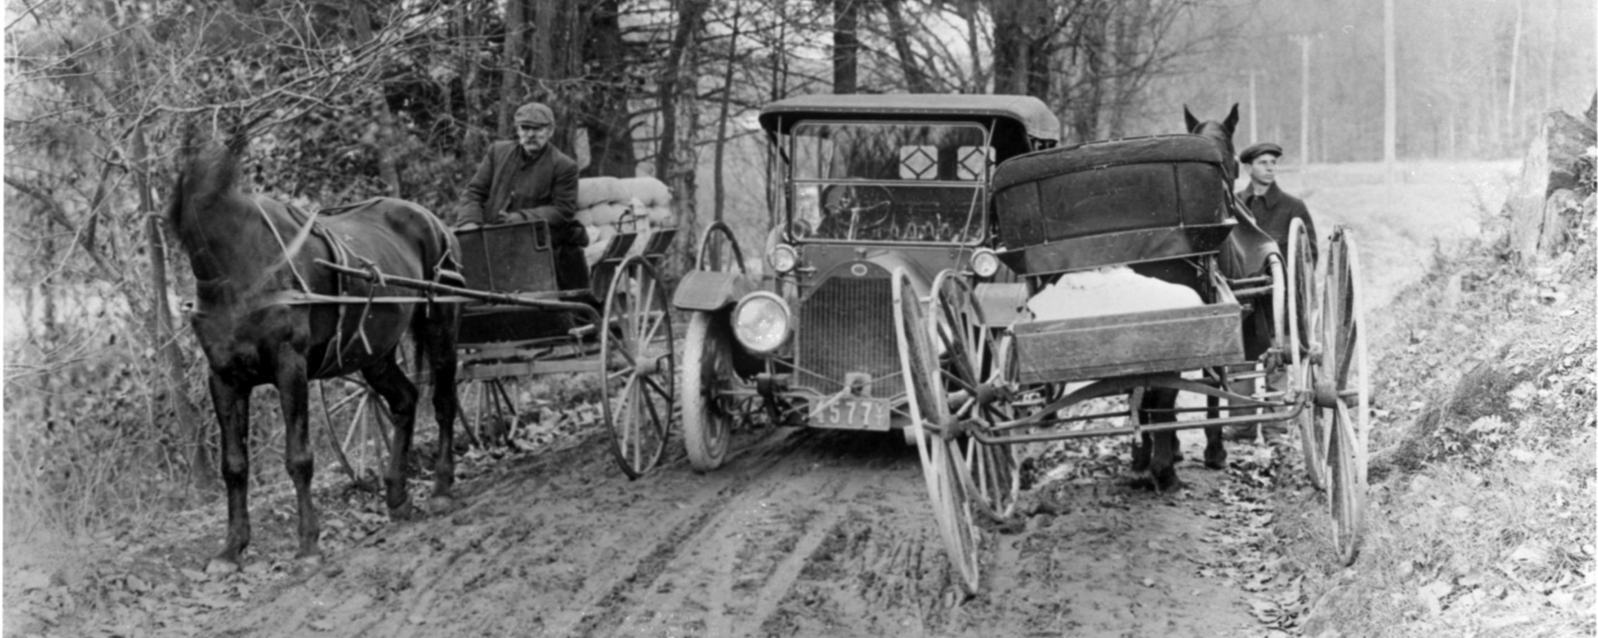
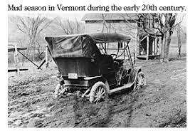
Vermont circa 1900
Most cities have electricity
Rural electrification is years in the future
Personal transport is horse drawn
Very few cars- 80% are steam or electric

Slide 4
Newport Vermont Circa 1920-1940
Newport, Vt 1940’s
Newport, Vt 1920’s
Almost all cars are powered by gasoline internal combustion engines

Slide 5
US Motor Vehicle Ownership 1900 to 1940/EV 2011 to 2030
1900 – 8,000 motor vehicles
1910 – 468,500 including 10,123 trucks
1920 – 9,239,161 including 1,107,639 trucks
1930 – 26,749,853 including 3,674,593 trucks
1940 – 32,453,233 including 4,886,262 trucks and 101,145 buses
2011 – 17,731 EV’s in the US
2015 – 113,773 EV’s in the US
2019 – 1,180,000 EV’s in the US
2021 – 2,200,000 estimated EV’s in the US
2025 – 6,000,000 estimated EV’s in the US
2030 – 18,700,000 estimated EV’s in the US – 7% of market
https://www.eei.org/resourcesandmedia/newsroom/Pages/Press%20Releases/EEI%20Celebrates%201%20Million%20Electric%20Vehicles%20on%20U-S-%20Roads.aspx
https://www.edisonfoundation.net/iei/publications/Documents/IEI_EEI%20EV%20Forecast%20Report_Nov2018.pdf
https://www.iea.org/reports/global-ev-outlook-2019

Slide 6
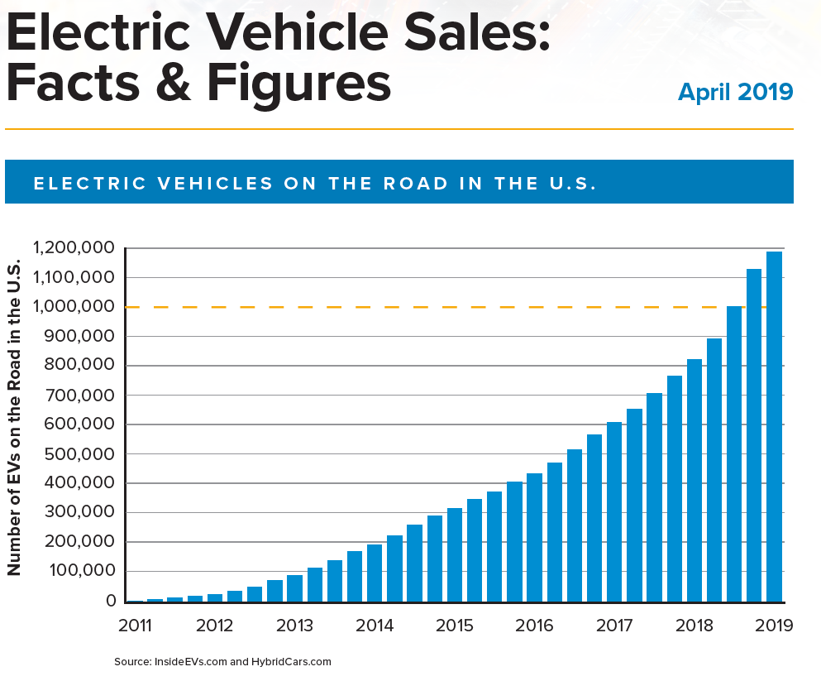

Slide 7
Technology Advancement
Technology moves in fits and starts
Sudden technological breakthroughs can lead to significant disruptive economic shifts
Electric vehicle batteries are breaking previous chemistry constraints
Manufacturers are investing billions in EV manufacturing infrastructure and supply chains
EV technological adoption may come faster than the grid is prepared to support
We need to ask different questions and look at vehicle electrification from a new perspective

Slide 8
Battery and Power Terminology
Ampere-hours battery capacity is the discharge current a battery can release over time –typical starting batteries are rated at 12 volts and 48 amp hours; The Tesla Model 3 extended range battery is rated at 350 volts and 230 amp hours.
Watt-hours (Wh) Measure of specific power a battery can deliver over time
Kilowatt hour (KWh)- eg.100 watt/hr used in defining EV battery specific power
Kilowatt hours/mile KWh/mile is the term that determines how much battery power is required to move a EV vehicle one mile replacing miles per gallon metric used with Internal Combustion Engine (ICE) vehicles.
Megawatt (MW)- 1 million watts is the standard power industry term to describe power generating facility rating
Megawatt hour (MWh) A unit for measuring electric power or the rate at which energy is produced or consumed; equal to 1,000 kilowatts of electricity used for one hour, or 1,000 kilowatt-hours.
Gigawatt hours (GWh)- 1 billion watt/hours a less common term used by ISO New England to describe monthly supply of electricity to the grid
Terawatt hours (TWh)- 1 trillion watts/hr used by National Renewable Energy Lab (NREL) to describe annual power required nationally to electrify various economic sectors

Slide 9
Automaker Electric Vehicle Investments and production
Automakers plan $300 billion investments in EV’s over ten years– 45% ($135B) in China and $82B Europe
Nearly half of the current EV vehicles are in China
A complete range of all vehicle classes have been announced - cars, SUV’s, pickups, buses, delivery trucks and class 8 semi trucks
This highly competitive market is already driving to ever larger battery capacity vehicles in all vehicle classes
The International Energy Agency’s high end global EV production estimate is 100 million EV’s by the year 2025 and 250 million by 2030 while most forecasts are half as much or lower
https://www.iea.org/reports/global-ev-outlook-2019

Slide 10
Electric Vehicle Technology Advances
1996-99 GM EV-1 – NiMH 26.4 KWh battery range 105 miles
2011 Chevy Volt - 16 KWh battery range 35 miles plus 1.4L gasoline engine
2016 Chevy Volt - 18.4 KWh battery range 53 miles plus 1.4L gasoline engine
2018 Nissan Leaf - 40 KWh battery range 151 miles
2020 Chevy Bolt - 66 KWh battery range 259 miles
2020 Tesla Model 3 - 75 KWh battery range 325 miles
2020 Tesla Model S Extended Range (+) 100 KWh battery – 390 miles
2021 Rivian Automotive RT1 pickup/RS1 SUV–180 KWh battery range 400 miles
Ford EV F150 – 200+ KWh battery/range?
Battery costs declined 87% between 2010 and 2019 allowing EV automakers to build bigger battery packs with more range at lower cost

Slide 11
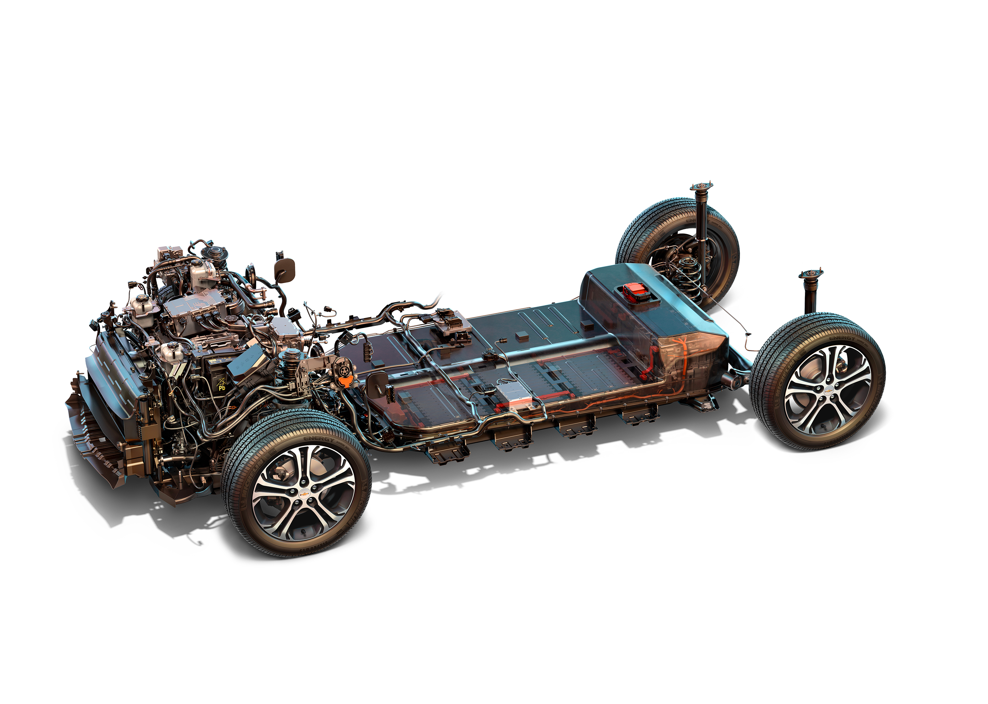
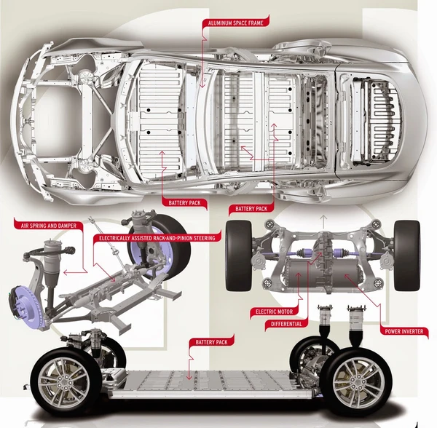
The Electric Vehicle Skateboard Design
Permanent Magnet Synchronous Reluctance Motor
https://chargedevs.com/features/teslas-top-motor-engineer-talks-about-designing-a-permanent-magnet-machine-for-model-3/
Chevy Bolt electric motor/battery layout
Tesla single electric motor/battery layout

Slide 12
Medium and heavy trucks
Daimler eCascadia Freightliner tractor trailer and box truck tests use 300 KWh to 550 KWh batteries with a range of 250 miles
Tesla describes its class 8 semi truck as having 300-500 mile range requiring a 600-1,100 KWh battery
Innolith battery technology claims 1000 KWh for its pre-production battery giving a 600 mile car range

Slide 13
Daimler-Freightliner Electric Trucks

Slide 14
Next Generation Electric Vehicle Technology is Here
Current EV technology will become obsolete quickly
The next generation leap-ahead EV technology is going into production
This is a potentially disruptive technology
The power requirements for these vehicles may require up to 50% more power than currently produced nationally.
We need to start planning for significant EV power demand and infrastructure implementation.
Emissions will drop as a result of this technology if the infrastructure is there to support it.

Slide 16
National Renewable Energy Lab Transportation Electrification Studies
The NREL Electrifications Futures Study released June 2018 analyzed residential, commercial, industrial and transportation sector electrification
Estimated annual power demand for three scenarios between 2020-2050
Transportation electrification created the largest power demand –building/industrial electrification required only 360 TWh/yr increase
Baseline scenario demand 4,722 TWh/yr assuming a gradual introduction of electric vehicles and other sector electrification
Mid-range 5,520 - 5,871 TWh/yr – in between baseline and high scenarios
High – 6,280 - 6,846 TWh/yr based on significant transportation electrification most LDV’s, med/hvy trucks - only 10,000 of 983,232 buses
The EIA estimates that national annual power supply available in 2020 as 4,126 TWhr and that the power supply in 2050 will be 5,429 TWhr
https://www.nrel.gov/docs/fy18osti/71500.pdf
EIA Annual Energy Outlook (AEO 2020) estimates https://www.nrel.gov/docs/fy18osti/71500.pdf

Slide 18
ISO New England Draft Transportation Electrification Study Dec 2019
ISO New England draft vehicle electrification study released 20 December 2019 analyzed northeast states transportation electrification
Covered 2019-2029 time frame and light duty vehicles (LDV) only
Estimated an increase from 41,349 BEV/PHEV out of 12,452,628 LDV’s in 2018 to 515,683 EV’s in 2029
Estimates Vermont EV share to grow from 2,926 to 36,492
Estimates the annual power demand for EV’s by 2029 as only .4 GWhr out of 160 GWhr monthly supply
This estimate is good through the early study period though it would be too low at 2030 and beyond because it excludes large truck fleet conversion to EV’s
https://iso-ne.com/static-assets/documents/2019/09/p3_transp_electrification_update.pdf

Slide 19
Vermont’s Energy profile
Nationally Vermont produces 40% of its electricity but only 20% of its total energy needs
Vermont produces 2.18TWh electricity but consumes 5.53 TWh annually
The estimated Vermont additional annual power supply required for complete transportation sector electrification is 2.66 TWh
Including 13 million tourists and through traffic an estimated 3 TWh (+/-) total additional annual power will be required
https://legislature.vermont.gov/assets/Legislative-Reports/Weight-Based-Registration-Legislative-Report-12-13-2019-Final.pdf
https://accd.vermont.gov/tourism

Slide 20
Key Electric Vehicle Raw Materials
Massive EV manufacturing increases and demand for large battery packs may outstrip short-term lithium supplies slowing near-term EV production
Significant near-term supply constraint for EV mass production is the supply of rare earth element (REE) permanent magnets used in 93% EV vehicle motors
China dominates the REE market supplying 80% of the US's refined rare earth materials
China is electrifying it’s transportation sector much more quickly than the rest of the globe and its demand for permanent magnets will consume much of Chinese REE production
The REE’s are critical for all military forces, and the Defense Department has announced plans to stockpile the same REE's used in commercial electronics and EV permanent magnets.
The third effect is to impose an increasingly large environmental damage burden on areas of the world previously untouched by extractive mining and toxic minerals refining.

Slide 21
Transportation Electrification Risks
Transforming the transportation sector from its current multi-modal portable and storable energy supply. Nationally there typically exists 2-3 weeks on-hand hydrocarbon fuel supplies.
Interruptions and shortages occur but supplies are routinely moved as needed.
Transportation electrification depends on a single, non-portable/storable supply modality (grid transmission lines) subject to interruption over a wide area.
Battery electric storage is decades in the future. The entire future national battery electric storage projects planned for 2023 would provide enough power for 1/6th of ISO New England’s hourly generation for one hour.
https://www.eia.gov/todayinenergy/detail.php?id=40072

Slide 22
Transportation Electrification Risks
1998 Northeast Ice Storms destroyed a large swath of the grid including 1,000 transmission towers and 13,000 utility poles. Over 4 million customers were left in the dark for days to weeks across parts of New York, Vermont, Maine, and southern Canada and 44 people died mostly from hypothermia.
2003 Northeast Blackout caused by a software bug left 50 million people without power for hours to days.
2011 Southwest Blackout caused by a technician switching error left 2.7 million customers without power for hours.
2012 Midwest derecho blackout across the Midwest and mid-Atlantic left 4.2 million people without power for hours or days
2012 Hurricane Sandy affected primarily New York and New Jersey with damage to both generating facilities and the grid. Outages affected 8.35 million customers for days to weeks.

Slide 23
January 2018 Northeast Cold Snap
New England was gripped by cold weather between December 25, 2017 and January 8, 2018
Monthly HDD is 20.6% higher than January 2017
Peak load of 20,599 MW was 5.1% higher than January 2017
Frigid cold drove up demand for natural gas which was consumed faster than it could be delivered
Gas pressure dropped in the lines feeding the natural gas power plants
Natural gas and fuel oil price inversion led to fuel oil being in economic merit and subsequently base loaded. As natural gas prices rose, the entire season’s oil supply rapidly depleted. Coal use also increased over normal use
Sea/river ice affected ship and barge deliveries to fuel oil terminals located in NH, ME and on the Hudson River
Trucking transport of fuel oil was the primary refueling constraint
Massachusetts Governor Baker signed hours-of-service waivers to provide fuel deliveries for residential and commercial customers, and power plants
To increase situational awareness, the ISO initiated semi-weekly then daily fuel surveys of oil-fired generation
37 natural gas issues were reported for the period, primarily Operational Flow Orders (OFOs) on Algonquin, Iroquois, and Tennessee Gas Pipelines; 2 in-region force majeure declared ISO-NE requested two conference calls with the Northeast Gas Association’s - Gas Supply Task Force
ISO-NE was in daily communications with interstate pipeline operators

Slide 24
Mitigate Risk
JFO, AOT, DPS, VELCO, and utilities calculate the total power required for transportation electrification in each power utility’s area
Establish a deliberate 10 year plan to electrify Vermont’s transportation consistent with grid/utility power supply
Identify and resolve utility and grid constraints
Identify risks and accept that electrification will not happen overnight
Identify and plan additional power generation
Review long-term power supply contracts
Increased DCFC charger power output
Recycling/reuse plan for batteries and permanent magnet motors

Slide 25
Questions

Slide 26
Vermont Transportation Emissions Reduction Factors 2025-2030
H.688 required 2025 Greenhouse Gas reductions = 110 million fewer E10 equivalent gallons/yr
EV mass production
begins 2022
2030 global EV sales estimates 21 – 44 million w/50% China
EV medium truck/bus battery packs w/300 KWh batteries=4X power density of a Tesla Model 3’s
Pickup/SUV EV battery packs w/200 KWh batteries= 3X the power density of Tesla Model 3’s
EV semi truck battery packs w/500-1,000 KWh batteries=7-14X of Tesla Model 3’s
One Class 8 semi will use the electricity equivalent to that required for 12.8 average American homes – there are 2.752 million registered US semi-trailers
The EIA and ISO New England’s EV power demand forecast based on 2030 low end estimate
The NREL estimated annual power required for transportation sector electrification as 6,786 TWh vs 4,126 TWh today; ISO New England supplies 123.3 TWh annually

