Slide 1
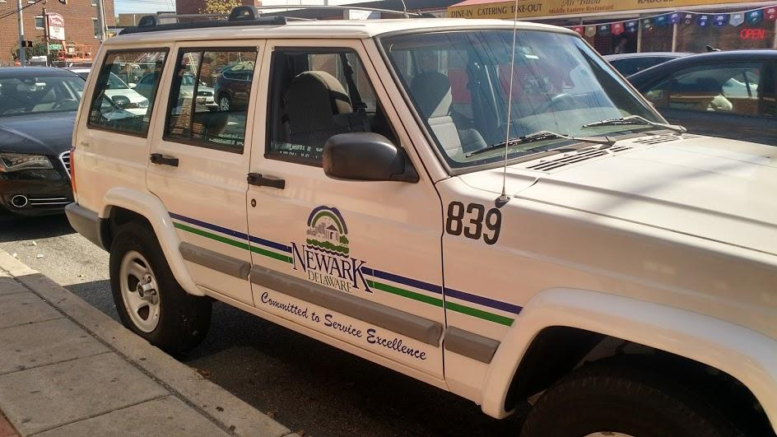
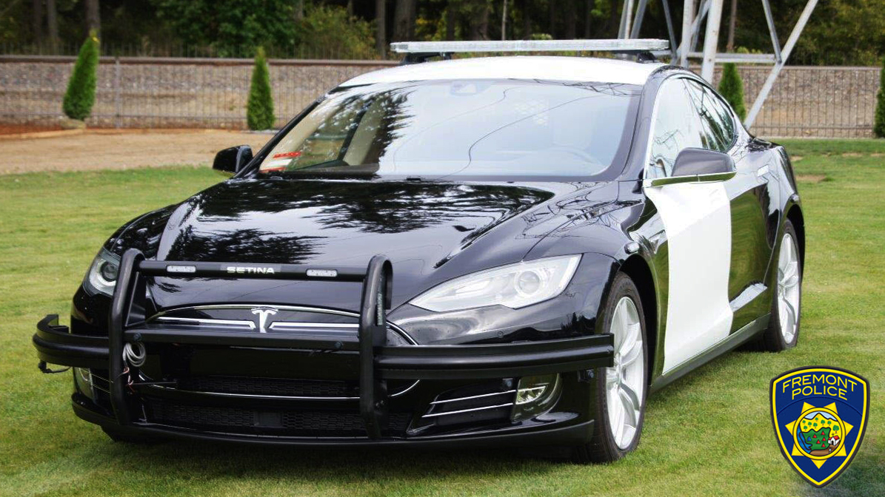
New Sparks for Newark's CARS
A Cost-Benefit Analysis of upgrading the City of Newark’s Vehicle Fleet to Electric
Notes:
Welcome to the future! We’ve been talking about it for years, and now it’s finally here! Isn’t this exciting?!
But wait? If this is the future, why are we still driving these old gas guzzlers? What about all those things we keep hearing about Climate Change? Where are all the flying cars we were promised?
-----------------
https://www.reddit.com/r/Jeep/comments/5nd8y7/the_city_of_newark_de_is_still_using_this_xj_as_a/
https://jalopnik.com/fremont-police-replaced-an-old-dodge-charger-with-a-tes-1832059459
https://mashable.com/article/tesla-model-s-fremont-police-patrol-ev/#I35D3hsHQaqX

Slide 2
TWO PROBLEMS
1. Aging high emissions vehicle fleet requiring more maintenance
2. Cost of Vehicle Replacement
Notes:
Well, it appears that we’re stuck in a point in time when we’re facing two major problems that affect every level from households, cities, countries, even the whole world:
1. Dirty vehicle emissions from aging vehicles that require increasing amounts of maintenance.
2. The high cost of vehicle replacement. For example, a new Tesla Model S runs about $75K to $135K, depending on selected options. This one was recently purchased and configured for Police duty in Fremont, California.

Slide 3
Agenda
2 Problems
Challenges and Solutions
Take Action
Benefits
Conclusion
Notes:
I am going to suggest a possible solution for these two problems that also addresses perceived challenges. I’ll then detail a plan to take action, cover the benefits, and conclude with an open discussion.
Full bias disclosure: I drive an EV and own some stock in Tesla, but my motivation for all of this is to save the city money while going green. This is not a sales pitch and I will not directly profit from any of this.

Slide 4
2 Problems
Dirty and Expensive
Notes:
To begin, let’s look at what challenges are in the way of solving these two problems and how we will past them.

Slide 5
Problem 1: Vehicle Emissions
(Millions of tons)
Notes:
To understand Problem 1, the topic of Global Climate Change is long and complicated, so I’m not going to go into any great detail here. I would like to point out though, that Governor Carney pledged Delaware with 19 other states committed to the US Climate Alliance in 2017. The Alliance aims to reduce emissions by 26 to 28 percent from 2005 levels and meet or exceed the targets of the federal Clean Power Plan and the Paris Climate Accord. As things stand right now, it looks like we’re going to be close, but our planet is not going to make it.
---------------
FIGURE ES-1 U.S. Climate Alliance progress under today’s policies sets the stage for accelerated action
Net GHG emissions from Alliance states, million metric tons carbon dioxide (CO2) equivalent.
SOURCE: Rhodium Group’s U.S. Climate Service NOTES: GHG emissions estimates reflect emissions from power generated within state boundaries. Uncertainty in CO2 sequestration from forests and other lands are derived from U.S. Environmental Protection Agency (EPA) and U.S. Department of Agriculture (USDA) estimates. Federal rollbacks include federal Corporate Average Fuel Economy (CAFE) standards, EPA and Bureau of Land Management (BLM) methane standards for oil & gas activities and landfills, and EPA’s Significant New Alternatives Policy (SNAP) Rule 20 and the Kigali Amendment for phase-down of hydrofluorocarbons (HFCs). For more information see the Technical Appendix. Emissions from Puerto Rico include only CO2 associated with fossil fuel consumption.
https://www.usclimatealliance.org/
https://news.delaware.gov/2017/06/05/delaware-joins-u-s-climate-alliance-to-uphold-goals-of-paris-agreement/

Slide 6
Problem 1: Vehicle Emissions
Notes:
The transportation sector is now the largest source of U.S. greenhouse gas emissions at nearly 2 Billion metric tons of CO2 per year and 60% of that comes from light duty vehicles like cars.
-----------------
Source: US Energy Information Administration
https://www.eia.gov/
https://www.c2es.org/content/regulating-transportation-sector-carbon-emissions/

Slide 7
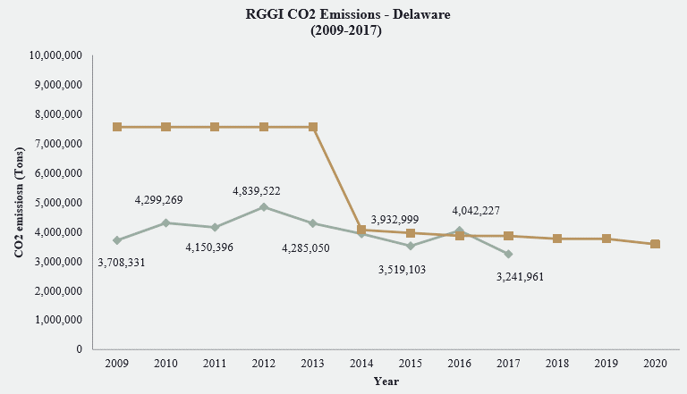
Problem 1: Vehicle Emissions
Emissions Cap
Electricity Generation
Emissions
Notes:
In 2017 alone, Delaware produced about 3.2 million tons of CO2 emissions.
Delaware is a founding member of the 9-states in the Regional Greenhouse Gas Initiative, which has so far been successfully capping and trading CO2 emissions from electricity generation, but much more can be done for transportation.
----------------
https://www.rggi.org/
https://www.epa.gov/de/environmental-information-delaware
https://insideclimatenews.org/news/20122018/climate-change-solutions-transportation-cap-and-trade-northeast-states-washington-california-model-rggi

Slide 8
Problem 2: Cost of Vehicle Replacement
Notes:
Now let’s shift over to Problem 2; the high Cost of Vehicle Replacements. I was able to obtain the City of Newark Capital Improvement Program for the next five years, thanks to the help of the CAC’s own Paralegal, Whitney Potts, and the Director of Public Works, Tim Filasky. One thing that stands out is the gross cost to replace city vehicles over the next five years… Over SEVEN. MILLION. DOLLARS. $1.7 million in 2019 alone!
And that’s not even counting the cost of fuel, maintenance, and other expenses.
So, do any of you know a way we could reduce CO2 emissions and maintenance, while also reducing the total cost of the city’s fleet?
-------------
https://newarkde.gov/DocumentCenter/View/11366/2019-2023-CIP-AS-APPROVED-Web-Version

Slide 9
Electric Fleet Vehicles!
Notes:
The answer is obvious. Inexpensive mid-range Electric Fleet Vehicles!!! This picture is from Coral Gables, Florida, where in 2016 they began building a “Green Fleet” with 20 Electric Vehicles (or “EVs” for short). They are now up to 43 EVs and have a goal of 78 by 2021. Counting the addition of 6 public charging stations, they have totaled over 10,700 charging sessions, reduced gasoline consumption by over 12,000 gallons and eliminated over 40 tons of greenhouse gas emissions.
But if the answer is so obvious, why don’t we have city EVs in Newark yet?
------------------
https://www.coralgables.com/electricvehicles
https://en.wikipedia.org/wiki/Coral_Gables,_Florida
Population: about 51,000. Compared to Newark at about 32,000

Slide 10
Challenges and Solutions
Some say it can’t be done
Notes:
What challenges are in the way and how do we get past them?

Slide 11
Challenges
“EVs don’t have enough range”
“There aren’t enough charging stations”
“EVs are too expensive”
Notes:
We’ve all heard and probably even said ourselves some of the common reasons why EVs are not prevalent on the roads today, such as not having enough range or places to charge, and being too expensive. All of those were true up until very recently, but right now we are in the midst of a dramatic change in the auto industry.

Slide 12
CHALLENGES AND SOLUTIONS
“EVs don’t have enough range”
Range (Miles)
Newer EVs have longer range
Range is extended at slower speeds
City EVs have better range than commuters
Newer EVs have longer range
Range is extended at slower speeds
City EVs have better range than commuters
Notes:
Earlier EVs were limited by range and that “Range anxiety” has prevented many drivers from considering an EV. But most newer EVs now get well over 100 miles on a charge and can be fast-charged during rest stops on longer trips. The newest EVs coming out now are pushing the range frontier beyond 200, -even 300 miles on a single charge.
Also, Like any vehicle, the slower you drive it, the less resistance it encounters from the air. And, since EVs have regenerative breaking, they have better efficiency and longer range at city speeds than at highway speeds, which makes EVs ideal for city fleet vehicles.
------------------
(Average and peak city vehicle trip info needed for range requirements.)
http://www.wiredfocus.com/us-electric-car-range-will-average-275-miles-by-2022-400-miles-by-2028-new-research-part-1/

Slide 13
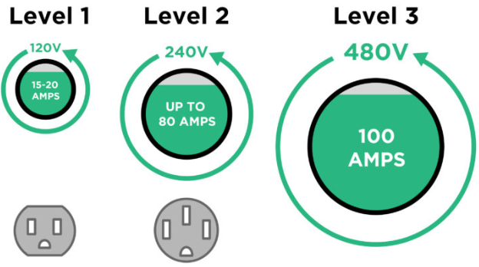
CHALLENGES AND SOLUTIONS
“There aren’t enough charging stations”
Notes:
Another challenge with EVs is that they need Electric Vehicle Support Equipment, more commonly called “Charging Stations” to recharge their batteries.
A Level 1 charger is portable, typically comes with the EV, and can be plugged into any compatible standard wall outlet, but it can take a long time to charge the newer long-range EVs. About 8 hours, depending on the vehicle’s capacity.
A Level 2 charging station however, is typically about the size of a toaster, it’s wall-mounted or pedestal mounted, and takes half the time as level 1, since it uses twice the power. So, about 4 hours instead of 8 to fill up. These are most common for homes and city fleets, installed wherever the EVs are parked overnight.
Lastly, there are Level 3 charging stations. These are about the size of a refrigerator, they use high voltage DC power fed directly to the vehicle’s battery and can “fast charge” in less than an hour! However, their higher cost usually means they only make sense at highway truck stops and gas stations.
-------------
https://www.pluglesspower.com/learn/bmw-i3-charging-ultimate-guide/

Slide 14
CHALLENGES AND SOLUTIONS
“There aren’t enough charging stations”
ChargePoint and Nuvve examples
Paid for using discounts, grants from the Regional Greenhouse Gas Institute or VW Mitigation Plan, savings from maintenance and gasoline, and 75% state rebate
Notes:
Shown here is a Level 2 option from a mainstream charging station company called Charge Point and another from Nuvve, a company that was founded in a University of Delaware lab by two graduate students and is the first US charging station company to offer Vehicle-to-Grid capability. I had a web conference with them and they sounded very excited for the opportunity to put their pride and joy into service here in their home territory. The price point of their charging station is competitive with Charge Point, but could pay for itself and stabilize the grid if used to it’s full capability.
Funding for charging stations can come from a combination of manufacturer discounts, possible grants from the Regional Greenhouse Gas Institute or the VW Mitigation Plan, and savings from maintenance and gasoline. These permanently installed base stations also qualify for a state rebate of 75% up to $5,000 each, not counting the cost of installation. I believe this topic was discussed during last month’s CAC meeting and George Irving may have some new information on it too, after this presentation.
------------------
https://www.chargepoint.com/
https://afdc.energy.gov/fuels/electricity_charging_workplace.html
https://nuvve.com/

Slide 15
CHALLENGES AND SOLUTIONS
“EVs are too expensive”
Federal $7,500 tax credit for municipal leases
DNREC $3,500 rebate
Use the fuel budget
Sustainable Energy Utility loan
Climate Mayors website has pre-negotiated rates
Notes:
But, didn’t we just talk about how Electric Vehicles are too expensive? Well, yes, there certainly are a lot of luxury EVs on the market that get a lot of attention in the media. But there’s also a growing number of workhorse EVs that have increasingly impressive specs and are relatively much more affordable. So much so, that some are now less expensive than most petroleum-fueled vehicles over their lifecycle, as we’ll get to in the next section.
#To make matters even sweeter, there is also the Federal Tax Credit of up to $7,500 #and the Delaware EV Rebate of up to $3,500.
And while some EVs may cost more up front, since they consume no gasoline, the savings in the fuel budget can be applied to the purchase of the vehicle. #I also spoke with Tony DiPrima from The Sustainable Energy Utility and they are offering us a 2-3% interest loan for EV and charging station expenses, just as they did for Newark’s LED streetlights project.
#Perhaps best of all, since purchasing government vehicles requires a potentially complicated competitive bid process, there’s a non-profit organization called, The Climate Mayors that made the government acquisition process easy through their website with pre-negotiated rates from approved vendors. Over 400 other cities are already charging down the road with this in front of us, so why not join them?
-------------
http://climatemayors.org/
https://www.dmv.org/de-delaware/green-driver-state-incentives.php
https://dnrec.alpha.delaware.gov/
https://newarkde.gov/1067/Newark-Community-Sustainability-Plan
http://driveelectricnoco.org/
https://www.energizedelaware.org/sustainable-energy

Slide 16
Take Action
Let’s do this
Notes:
Are you ready to take action?

Slide 17
Notes:
So, what if we decided right now that, yes, we want to do this. How would it work?
Moving forward is as simple as going to climatemayors.org and clicking Visit the EV Platform. *Click*
------------------
“Climate Mayors, founded in 2014, is a bipartisan, peer-to-peer network of U.S. mayors working together to demonstrate leadership on climate change through meaningful actions in their communities, and to express and build political will for effective federal and global policy action.” © 2017 Climate Mayors

Slide 18
Notes:
Through the EV Purchasing Collaborative, you can:
Shop for EVs.
Learn about the Procurement Process.
Read about success stories in other cities.
Get your questions answered.
Let’s click on “Available Electric Vehicles”
----------------------
https://driveevfleets.org/

Slide 19
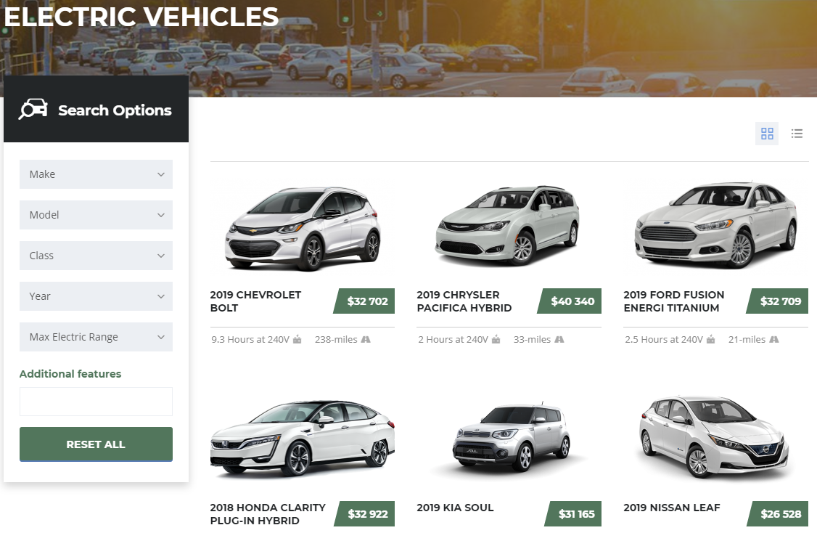
Notes:
Here, you can browse just like many other car shopping sites, only this one is approved for government fleet purchases via Sourcewell and the prices are already pre-negotiated.
There are currently 7 available models to choose from. Spoiler Alert; one of them clearly has the best price, stats, and has become the ubiquitous city fleet EV across the board with other cities in this program for many good reasons.
Can you guess which one?

Slide 20
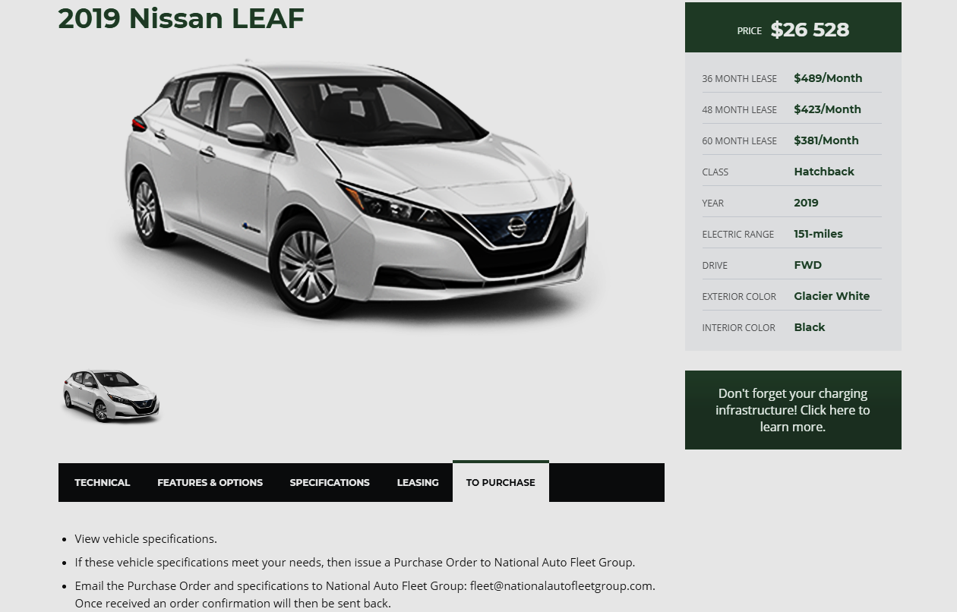
$15,528
Notes:
The Nissan Leaf. Sourcewell has negotiated the price down from an MSRP of about $30,000 to about $26,500. After rebates, the final cost is only about $15,500. The 40 Kw battery gives us an EPA-estimated 151 miles of range on a full charge, which should get you and 3 co-workers anywhere in the city all day long, even if you forget to charge the night before. If that’s still not enough range for you, as of this year and for about $5,000 more, there’s now a 60 Kw battery that gets about 225 miles.
Leaf is also the only currently available EV in the US readily capable of Vehicle-to-Grid without any special modifications and it won Kelly Blue Book’s 2019 Best 5-Year Cost to Own award for EVs.
(Explain buy vs. lease tradeoff caveat.)
--------------------
https://www.kbb.com/new-cars/5-year-cost-to-own-awards/best-cto-electric-vehicle/
https://electrek.co/2018/10/18/nissan-leaf-2019-long-range-60-kwh-battery-pack-dealer-document/

Slide 21
Notes:
(Optional: ctrl+click slide to play video at 1 minute mark.)
The EV Purchasing Collaborative uses Sourcewell to make it easy for government agencies to purchase pre-negotiated and approved suppliers of EVs.
Newark already has an account with Sourcewell that Tim Filasky currently uses for the city’s Vehicle and Equipment Replacement Program.
So, if the decision is made to purchase EVs, Tim can simply use Sourcewell through the EV Purchasing Collaborative in the same way he has for his other purchases.
-------------------
https://www.sourcewell-mn.gov/
https://youtu.be/yrZJLXmqkeA

Slide 22
Benefits
Show me the money!
Notes:
This last section looks at the benefits.

Slide 23
Electrified Transportation System
Notes:
An electrified transportation system is powered by a wide variety of domestic sources which reduce our dependence on oil. It costs less to own and operate because electricity rates are low and stable, which insulates public fleets from volatile oil markets.
---------------------
https://www.denvergov.org/passgas

Slide 24
Buy the Numbers
Cost of current 5-year vehicle replacement plan for 11 sedans:
$299,000
Cost of 5-year EV plan for 11 Nissan Leafs and 6 ChargePoint CT4000s:
$179,874
Procurement Savings:
$119,126
Notes:
By now you might be thinking, “That all sounds great and all, but I want to know how much MORE this will cost us than the current plan.” Well, here’s the numbers and the good news.
The cost of the current 5-year vehicle replacement plan for 11 sedans is almost $300K.
The cost over the same 5-years to upgrade to 11 Nissan Leafs and ChargePoint charging stations, minus all the rebates I talked about earlier, is just under $180K.
That’s a SAVINGS of # …almost $120,000 for just procuring the first 11 EVs in the fleet. I should point out that there is a relatively minor follow on cost for software support. Also, the installation parts, and labor are not included in this figure, but the installation should be able to be performed internally by our own electrical department. So this calculation should be pretty close.
--------------------
The cost of a 5-year EV upgrade: (($26,520 per 2019 Nissan Leaf - $7,500 federal rebate - $3,500 state rebate) x 11 cars) + (((($6,695 Charge Point CT 4021 x 5) + $7,210 Charge Point CT4021-GW1) x 10% CM discount) – 75% state workplace rebate) = $179,874 + software support, installation parts and labor, if we were to go with ChargePoint CT4000 charging stations.
…OR, substitute a 5-year ChargePoint as a Service (CPaaS) for $36,000 instead of the $9,154 up front cost (not recommended). That’s $100 per month per port for 5 years.
$170,720 for 11 Leafs + $9,154 for charging stations = $179,874 EV Plan
*In case you were wondering why there’s two different Charge Point models shown, the more expensive one contains a cell-tower gateway. It’s needed to share a wireless network with the other non-gateway stations.
Additional Parts include any sub-panels, underground conduit, wiring, and concrete pads. Likely in the single-digit thousands. Rather than hiring outside contractors, installation labor can be performed by workers already on the city payroll.
https://smartchargeamerica.com/electric-car-chargers/commercial/chargepoint-ct4021-gw1-gateway-unit/
http://www.nyc.gov/html/dcas/downloads/pdf/fleet/Robert_Martinez_NYPD_The_Electric_Vehicle_Revolution_for_Government_Fleets.pdf

Slide 25
Buy the Numbers
Cost of current 5-year vehicle replacement plan for 11 sedans:
$299,000
Cost of 5-year EV plan for 11 Nissan Leafs and 11 Nuvve charging stations:
$185,020
Procurement Savings:
$113,980
Notes:
And here’s the comparison of ChargePoint to the Nuvve charging station. #It’s about $5K more up front, but keep in mind the Nuvve advantages. It’s a University of Delaware spinoff company, their software support is included in the price, and a Vehicle-To-Grid DC charger should be available soon that can pay for itself while stabilizing the grid. They are also working on Sourcewell offerings, charging stations with multiple connectors, and a cheaper pedestal to bring the price down further.
----------------------------
(($26,520 per 2019 Nissan Leaf - $7,500 federal rebate - $3,500 state rebate) x 11) + ((($1,200 Nuvve EVSEB-P1-H1 +$1,000 pedestal) x 11) – 75% state workplace rebate for the first 6 chargers) = $185,020 + installation parts and labor
$170,720 for 11 Leafs
$24,200 for discounted chargers
$3,300+$11,000 = $14,300 after state rebate
https://nuvve.com/
https://www.fleetcarma.com/latest-vehicle-grid-v2g-charging/
For V2G, they also have a 30 kW DC CHAdeMO station for about $10,000. While much more expensive up front, it can be expected to pay back about $1,000 per year by selling spare electricity back to the grid during peak times. If opting for the V2G station, Nuuve recommends using a monthly service model of $50-100 per station that includes the equipment and operation.

Slide 26
“Buy American” Option: Tesla Model 3
Cost of current 5-year vehicle replacement plan for 11 sedans:
$299,000
Cost of EV plan for 11 Tesla Model 3s and 11 Tesla charging stations, minus lifecycle fuel and maintenance savings:
$327,192
Lifecycle additional cost of 11 Tesla Model 3s:
$28,192
Notes:
I noticed that the majority of the current fleet comes from American manufactures, so here’s the All-American Tesla Model 3 option. As of May 27th, they now start at $39,900.
The cost of a 5-year EV plan for 11 Tesla Model 3s and 11 Tesla charging stations, minus lifecycle fuel and maintenance savings is about $327,000.
#So, Lifecycle Cost of 11 Tesla Model 3s is about $28,000
Pearl White is an extra $2,000 each if you really don’t want black, but that $24,000 paint job essentially brings our savings to a net zero. This just reminds me of Henry Ford’s Model T’s. You can have any color you want, as long as it’s black. Delivery takes about 6-8 weeks. If you account for rebates, Model 3s are about twice the procurement price of a base model Nissan Leaf, which is at least assembled in the USA. So, is it worth it?
There’s also the Chevy Bolt at $32,702 on the Climate Mayors site. New York and Maryland are currently testing them out with their police departments too. So…
------------------
The cost of a 5-year EV upgrade: (($39,900 per Tesla Model 3 + $1,200 Destination and Doc fee - $3,750 federal rebate - $3,500 state rebate) x 11 cars) = $372,350 net for car purchase
$500 Tesla charging station x 11 – 75% state workplace rebate on first six chargers = (($500 x 6) x .25) + ($500 x 5) = $3,250 net for charging stations
Cars + charging stations =$375,600+ installation parts and labor*. That’s about a $75,900 increase up front.
But, then factor in fuel and maintenance savings:
11 vehicles. 25,285 gallons of gasoline. Vs. Model 3. (64,545 avg mi / 124 MPGe city) x 11 = 5,726 lifetime “gallons”. 25,285 current gallons – 5,726 new “gallons” = 19,559 fewer gallons by switching to Model 3s. 19,559 gallons x $2.25/gallon average = $44,008
Oil changes: 11 vehicles x $40 per change x 2/year x 5 years = $4,400
So, the new 11-car EV plan becomes: $375,600 - $44,008 - $4,400 = $327,192 net
https://www.tesla.com/model3
https://www.freightwaves.com/news/trucking/tesla-buys-trucking-capacity-maybe
http://hyattsville.org/733/Electric-Police-Vehicles
https://www.government-fleet.com/157780/chevrolet-bolt-ev-patrol-car-hits-the-streets-in-md
http://www.nyc.gov/html/dcas/downloads/pdf/fleet/Robert_Martinez_NYPD_The_Electric_Vehicle_Revolution_for_Government_Fleets.pdf
*Additional Parts include any sub-panels, underground conduit, wiring, and concrete pads. Likely in the single-digit thousands. Rather than hiring outside contractors, installation labor can be performed by workers already on the city payroll.

Slide 27
What if Cops Drive EVs?
Notes:
Just for the fun of it, let’s look at how feasible it might be to upgrade the Police Department. Because, what cop wouldn’t want to chase down some suspects with one of these?!
-------------
https://www.smartmash.net/2018/02/19/tesla-model-x-taking-police-cars-to-a-new-level/

Slide 28
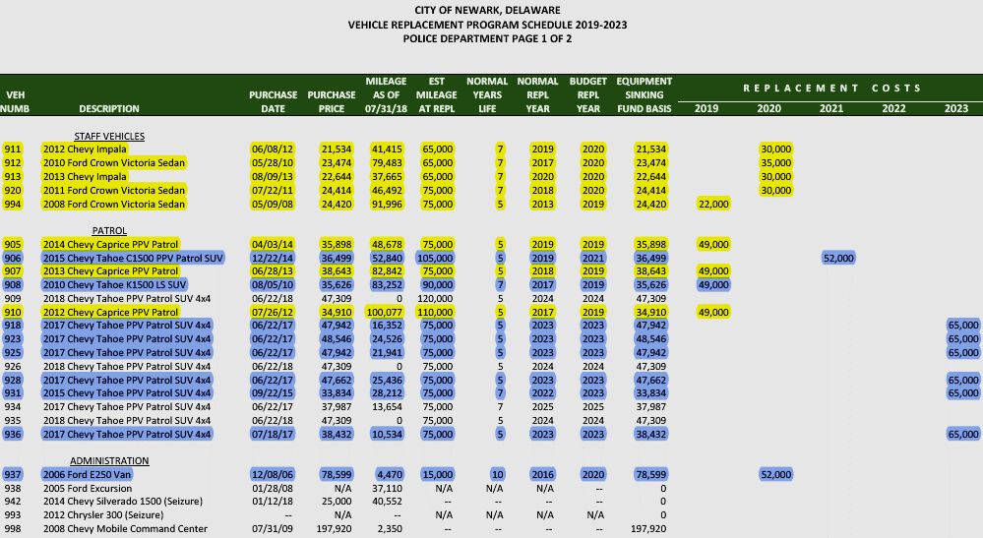
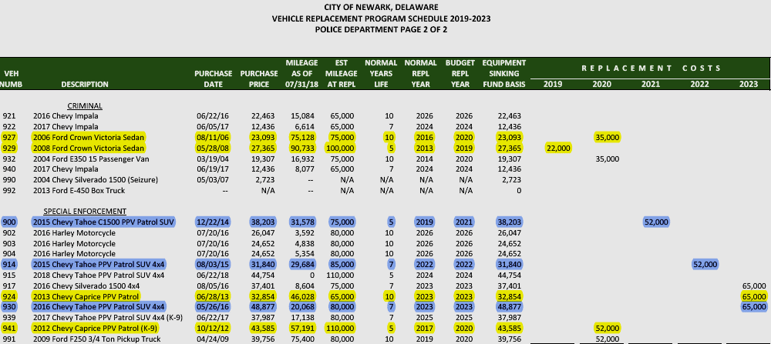
Vehicle Replacement Program Schedule - Police
Notes:
The Vehicle Replacement Program Schedule for the Police Department contains administrative vehicles and the familiar patrol vehicles. All 12 sedans might be candidates for replacement with Leafs, considering that the most demanding patrol cars now are Chevy Caprices with similar size and performance to the Nissan Leaf.
Q: Can anyone guess what the rated gas mileage of this Chevy Tahoe Police Vehicle is?
A: It’s only 15 mpg. And we have 17 of them. That’s a lot of gasoline consumption!
--------------------
Staff Vehicles, Patrol, Administration, Criminal, and Special Enforcement.
https://media.chevrolet.com/media/us/en/chevrolet/vehicles/caprice-ppv/2017.tab1.html
https://www.gmfleet.com/specialty-vehicles/police/chevy-tahoe-ppv.html

Slide 29
1
0
2
1
7
Model X
Model Y
Notes:
Let’s consider how the $65,000 SUV Procurement Price Point will likely change during the next five years. #The currently planned 11 replacement SUVs (shown in brown) get more expensive as they ramp up to $65,000 each in 2023. #For about the same price right now, we could buy one gently used Tesla Model X (shown in green) from various online dealers, that would outperform the pants off of a Tahoe.
No SUV purchases are planned for 2020, so that could give the police department time to thoroughly evaluate the Model X. At the same time, the first Model Ys (shown in white) are scheduled to roll off Tesla’s production line. The Model Y will also be an SUV, 10% larger than the Model 3 sedan and significantly cheaper than the Model X or the Tahoe.
#If the Model X evaluation goes as well as I hope it would, we could begin swapping all future SUV orders over to Model Ys, starting in 2021.
Note that the Teslas would still need Police mods at about $4K each, but this is more than made up by the $12K fuel savings from the Tahoes, as I’ll show on the next slide.
-------------------------
https://www.tesla.com
https://www.roadandtrack.com/new-cars/future-cars/a25048601/2021-tesla-model-y-everything-we-know/
https://electrek.co/guides/tesla-model-y/

Slide 30
1
0
2
1
7
Notes:
This is the same SUV group, but factoring in police modification, fuel, and oil change expenses. No surprise, it’s still cheaper in the long run to buy E-SUVs.
Let’s crunch some numbers.
-------------------------
Other maintenance expense data was not available, but likely would skew even further against the Tahoe
https://www.tesla.com
https://www.roadandtrack.com/new-cars/future-cars/a25048601/2021-tesla-model-y-everything-we-know/
https://electrek.co/guides/tesla-model-y/

Slide 31
What if Cops Drive EVs?
Cost of current 5-year vehicle replacement plan for 23 sedans and 11 police SUVs:
$1,414,000
5-year EV plan for 23 Nissan Leafs, 11 Teslas, 23 chargers, and 15 mods:
$882,193
Procurement Savings:
$531,807
Notes:
If we now include the police department, the current 5 year plan is estimated at about $1.4 million.
The cost over the same 5-years to upgrade to EVs; including 23 new Leafs, 11 Teslas, charging stations, rebates, and police modifications is less than $900,000.
Which means the total EV procurement cost, including the Police Department, #would save over half of a million dollars. Then on top of that, there’s the fuel and maintenance savings…
--------------------------------
Current CIP: $299,000 for 11 non-police sedans + $1,115,000 for 12 police sedans and 11 police SUVs = $1,414,000
Switching to EVs would cost an estimated ($356,960 for 23 new Nissan Leafs) + ($48,733 for 23 Charge Point and Tesla Chargers) + ($416,500 for 11 Tesla Model X/Y’s from the previous slide – $38,500 state rebate ) + ($60,000 for 15 police mods) = $882,193+ Installation Parts and Labor. Note that the state charging station rebate is limited to 6 chargers, but the remaining 17 should be eligible for grants from RGGI or the VW Mitigation Plan.
(($26,520 per 2019 Nissan Leaf - $7,500 federal rebate - $3,500 state rebate) x (11+12)) + (((($6,695 Charge Point CT 4021 x (5+5)) + ($7,210 Charge Point CT4021-GW1 x2)) x 10% CM discount + ($500 Tesla charger x 11)) – 75% state workplace rebate on first 6 chargers($30,000)) + ($65,000 for 1 used Tesla Model X + $39,000 for 10 Model Y’s) – ($3,500 state rebate x 11) + ($4,000 police mods x 15) = $882,193+ Installation Parts and Labor
https://shop.tesla.com/us/en/product/vehicle-accessories/silver-wall-connector.html?tesref=true
http://delcode.delaware.gov/title7/c060/sc02a/index.shtml
https://teslamotorsclub.com/tmc/threads/swiss-police-will-acquire-7-tesla-model-x-100d.111021/
https://evannex.com/blogs/news/why-the-tesla-model-3-could-be-the-police-car-of-the-future

Slide 32
Fuel and Maintenance
Gasoline saved with Nissan Leafs:
19,559 gallons
Gasoline saved if upgrading the police: 97,446 gallons
Fuel Savings if gasoline is $2.25 per gallon:
$263,261
Fewer moving parts
No oil to change:
$13,600
Less time in the shop
Less coordination for maintenance downtime
Notes:
Gasoline saved with Just the first group of Nissan Leafs – almost 20,000 gallons. Gasoline saved by also upgrading the Police department – about 100,000 gallons. Lifecycle fuel savings at the projected average of $2.25 per gallon – over a quarter of a million dollars.
Typical maintenance involves simply rotating the tires and topping off the windshield wiper fluid. That’s it. We would save almost $14,000 for 34 EVs, just for avoiding oil changes over 5 years. Plus a lot of the hassle and down time of having to take a vehicle out of operation for routine services.
-------------------
11 vehicles. 25,285 gallons of gasoline. Vs. 2019 Nissan Leaf. (64,545 avg mi / 124 MPGe city*) x 11 = 5,726 lifetime “gallons”. 25,285 current gallons – 5,726 new “gallons” = 19,559 fewer gallons by switching to Nissan Leafs.
23 vehicles. 113,639 gallons of gasoline. Vs. 2019 Nissan Leaf. 74,166.67 avg mi / 124 MPGe city* x 12 = 7,177 lifetime “gallons”. Tesla X/Y. 74,583.33 avg mi / 91 MPGe city* = 819.60 lifetime “gallons” x 11 = 9,015.6 total gallons. 113,639 current gallons – 7,177 new gallons (cars) – 9,015.6 new gallons (SUVs) = 97,446 gallons saved by switching to Nissan Leafs and Teslas.
Oil changes: 34 vehicles x $40 per change x 2/year x 5 years = $13,600
https://www.greencarreports.com/news/1115028_2018-nissan-leaf-electric-car-gets-151-mile-epa-range-rating

Slide 33
Lifecycle CO2 Emissions Reduction
Phase 1 – Leafs for everyone (11 sedans) …and commit to no new fossil-fueled vehicles!
253 tons of CO2 in current plan - 46 tons in new plan (conserv. est.) = 207 tons reduced
Phase 2 – Cops driving Teslas (23 cars and SUVs)
1,126 tons of CO2 in current plan – 130 tons in new plan (conserv. est.) = 996 tons reduced
Phase 3 – Pickup Trucks
Phase 4 – Other utility vehicles
Total (34 cars and SUVs)
1,203 tons of CO2 emissions saved over current lifecycle plan
Notes:
The easy win here is replacing every possible fleet sedan with a Nissan Leaf as they age out according to the current 5 year plan, saving over 200 tons of CO2. Also, commit to not buying anymore fossil-fueled vehicles. We should be able to extend the rest of the fleet out until a suitable EV replacement is available. If you want to kill a monster, first you have to stop feeding it.
In the short-term of about 1-2 years, the high priority is to start phasing in a used Tesla Model X and later several Model Y’s, saving an additional 1,000 tons or more. #Total savings: over 1,200 tons of CO2 emissions up to this point.
In the long-term of about 2-4 years, more complicated and expensive improvement should replace the remaining pickup trucks and other utility vehicles as cost-effective options enter the market.
----------------------------
5 x 2018 Ford Focus (last production year). 60,000 miles / 34 mpg city = 1,765 lifetime gallons x 20 lbs/gal = 35,294 lbs. of CO2 = 17.65 tons x 5 = 88.24 tons of CO2
3 x 2019 Toyota Camry Hybrid. 70,000 miles / 44 mpg city = 1,591 lifetime gallons x 20 lbs/gal = 31,818 lbs. of CO2 = 15.91 tons x 3 = 47.73 tons of CO2
1 x 2011 Ford Crown Victoria. 65,000 miles / 16 mpg city = 4,062.5 lifetime gallons x 20 lbs/gal = 81,250 lbs. of CO2 = 40.63 tons of CO2
1 x 2019 Dodge Durango. 70,000 miles / 16 mpg city = 4,375 lifetime gallons x 20 lbs/gal = 87,500 lbs. of CO2 = 43.75 tons of CO2
1 x 2019 Jeep Cherokee 4WD. 65,000 miles / 20 mpg city (avg) = 3,250 lifetime gallons x 20 lbs/gal = 65,000 lbs. of CO2 = 32.5 tons of CO2
Subtotal = 11 vehicles. 252.85 tons of CO2. Vs. 2019 Nissan Leaf. 64,545 avg mi / 124 MPGe city* = 520.53 lifetime “gallons” x 20 lbs/gal = 10,410.56 lbs = 5.21 tons x 11 = 57.26 total tons – 19.65% avg clean energy supply = 46 tons. 252.85 current tons – 46 new tons = 206.85 tons of CO2 saved by switching to Nissan Leafs.
2 x 2016 Chevy Impala. 65,000 miles / 18 mpg city = 3,611 lifetime gallons x 20 lbs/gal = 72,222 lbs. of CO2 = 36.11 tons x 2 = 72.22 tons of CO2
5 x 2011 Ford Crown Victoria. 65,000 miles / 16 mpg city = 4,062.5 lifetime gallons x 20 lbs/gal = 81,250 lbs. of CO2 = 40.63 tons x 5 = 203.15 tons of CO2
5 x 2017 Chevy Caprice PPV. 87,000 mile avg / 16.5 mpg city avg = 5,272.73 lifetime gallons x 20 lbs/gal = 105,454.55 lbs. of CO2 = 52.73 tons x 5 = 263.64 tons of CO2
11 x 2019 Chevy Tahoe PPV. 80,000 mile avg / 15 mpg city = 5,333.33 lifetime gallons x 20 lbs/gal = 106,666.67 lbs of CO2 = 53.33 tons x 11 = 586.67 tons of CO2
Subtotal = 23 vehicles. 1,125.68 tons of CO2. Vs. 2019 Nissan Leaf. 74,166.67 avg mi / 124 MPGe city* = 598.12 lifetime “gallons” x 20 lbs/gal = 11,962.37 lbs = 5.98 tons x 12 = 71.77 total tons – 19.65% avg clean energy supply = 57.67 tons. Tesla X/Y. 74,583.33 avg mi / 91 MPGe city* = 819.60 lifetime “gallons” x 20 lbs/gal = 16,319.94 lbs = 8.20 tons x 11 = 90.2 total tons – 19.65% avg clean energy supply = 72.48 tons. 1,125.68 current tons – 57.67 new tons (cars) – 72.48 new tons (SUVs) = 995.53 tons of CO2 saved by switching to Nissan Leafs and Teslas.
*MPGe city is the EPA-estimated power consumption. It doesn’t take into account the clean energy mix from the utility. DEMEC’s 2017 report showed 14.3% renewables with a 2025 goal of 25%, i.e. an 8-year average RPS of 19.65%. FWIW, the EPA says one gallon of gasoline equates to 33.7 kilowatt-hours.
https://www.ford.com/cars
https://www.fueleconomy.gov/feg/contentIncludes/co2_inc.htm
https://www.edmunds.com/ford/crown-victoria/
https://www.motortrend.com/cars/ford/transit/2019/

Slide 34
Phase 3: Pickup Trucks
Rivian
Atlis
Ford
Starting at $69,000
Starting at $45,000
Price not set yet
Notes:
Keep an eye out for EV trucks from companies like Rivian, Atlis, and Ford. While not in production yet, they are taking deposits on pre-orders and expecting to be available within the next two to three years.
------------------
https://products.rivian.com/
https://www.atlismotorvehicles.com/

Slide 35
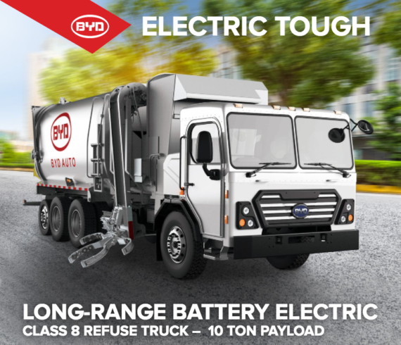
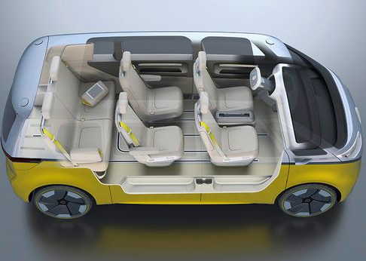
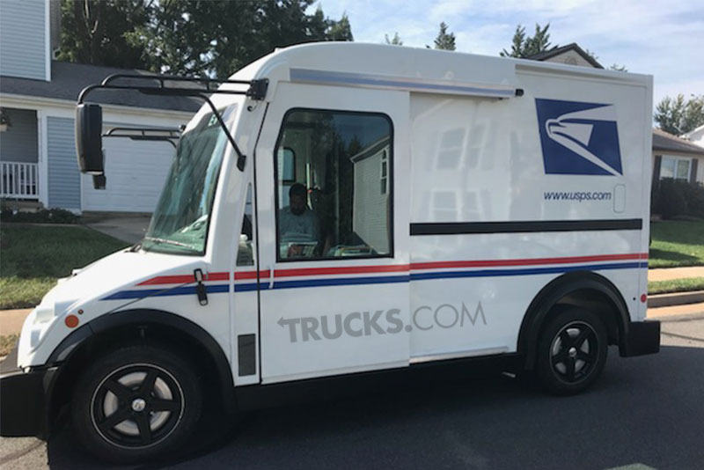
Phase 4: Utility Trucks
Garbage
Mail
VW Microbus
Notes:
…And then Phase 4 can be electric garbage trucks, mail trucks, etc. including transports like the VW I.D. Buzz Microbus to replace the vans I saw on the fleet list.
-----------------
https://cleantechnica.com/2017/11/21/byd-delivers-1st-electric-automated-side-loader-garbage-truck-city-palo-alto-greenwaste/
https://www.trucks.com/2017/10/09/spy-shots-postal-service-workhorse-electric-mail-truck/
https://www.vw.com/electric-concepts/section/id-buzz/

Slide 36
Fleet Pool Dispatch
View all vehicles available within a geofence and their current state-of-charge (if electric)
Notes:
Another way to save is to follow other cities that have streamlined their operations even further by establishing a Fleet Pool Dispatch system. Rather than each department having assigned vehicles that are mostly the same type (sedans), they place most of the sedans into a pool which are then dispatched to individual drivers using a reservation system. This reduces cost of the fleet by increasing the utilization rate and decreasing the required size of the fleet without restricting operations.
So, we could start by getting FleetCarma software, putting most sedans into the pool, and reducing the Leaf order by one. Instant savings of about $25,000
-------------------
Grand total savings: $531,807 Procurement (incl. Police) + $263,261 fuel + $13,600 oil changes + $25,000 = $833,668 (plus maintenance savings – installation parts).
https://www.fleetcarma.com

Slide 37
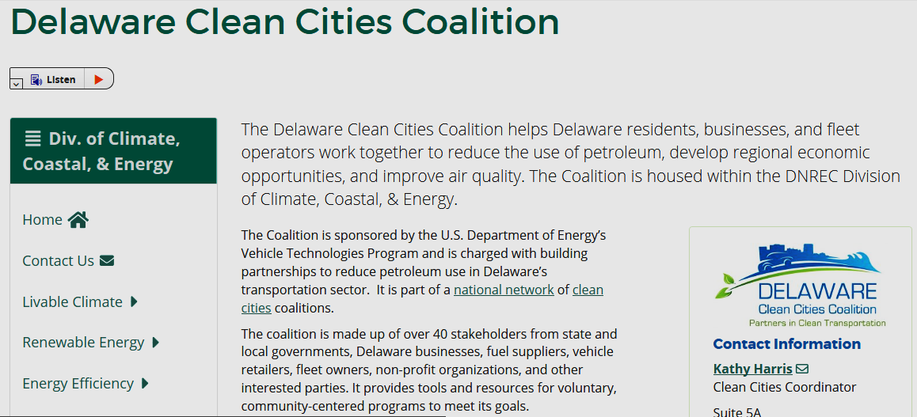
Notes:
Other benefits of City EV Fleets include participation in the:
Clean Cities Coalition with possible grants from the Regional Greenhouse Gas Institute and a 2-3% interest loan from the Sustainable Energy Utility, like I said earlier.
--------------------
“(4) Ten percent of CO2 allowance proceeds shall be directed to Greenhouse Gas Reduction Projects, selected by the Secretary following a periodic competitive proposal process. The Secretary shall utilize an advisory body composed of electric generators, environmental advocates, legislators and such others as the Secretary may find useful in developing guidelines for the proposal process and in soliciting and ranking of projects. Projects must result in quantifiable and verifiable reductions in Greenhouse gas emissions in Delaware not otherwise required by federal or state law and not receiving funding from any other state sources.”
https://dnrec.alpha.delaware.gov/climate-coastal-energy/clean-transportation/delaware-clean-cities-coalition/

Slide 38
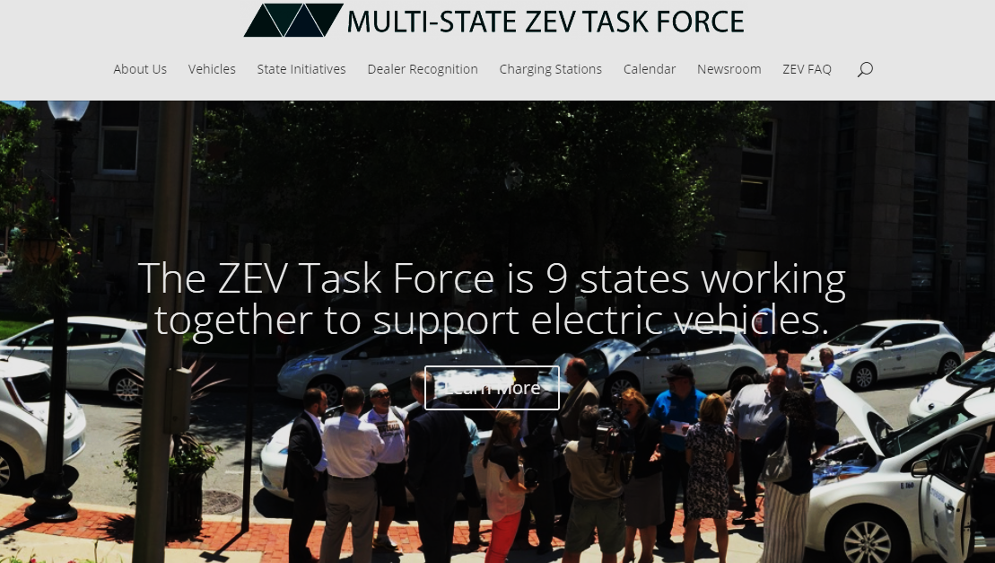
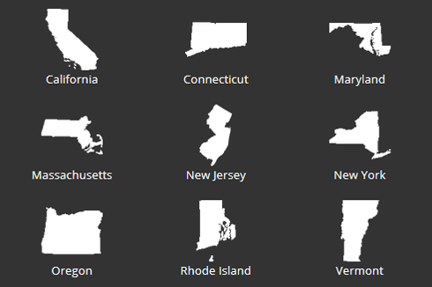
Notes:
…And momentum to join the multi-state Zero Emission Vehicle Task Force, which includes our neighbors in Maryland and New Jersey. I mean, if MD and NJ can do it, so can we!
----------------------
“On October 24, 2013, the governors of eight states, joined by a ninth on May 3, 2018, signed a memorandum of understanding (MOU) committing to coordinated action to ensure the successful implementation of their state zero-emission vehicle (ZEV) programs. Collectively, these states are committed to having at least 3.3 million ZEVs operating on their roadways by 2025. The MOU identifies joint cooperative actions the signatory states will undertake, and additional actions that individual jurisdictions are considering, to build a robust market for ZEVs. For more information about the Task Force, see the Multi-State ZEV MOU and Multi-State ZEV Action Plan.”

Slide 39
Summary & Discussion
City fleet EVs aren’t just good clean fun. They are also safer, cheaper, and more reliable than fossil-fueled vehicles
Notes:
The over $830,000 dollars saved by adopting EVs over the next 5 years can be used by the city to support it’s other priorities, such as paying off debt, assisting small businesses and low-income families, and funding other green programs. We can even vinyl-wrap graphics on the EVs to promote them, like other cities do. Our fleet can gain local and national recognition for leading by example, which will encourage Newark residents and neighboring cities to do the same.
If anyone is interested in the information sources or the math behind these slides, I’ve included it in the notes of this presentation. At this point, I would like to open the floor for discussion.
---------------
“Though humans have a strong tendency towards denial, it is possible to choose to bypass it, if we deliberately decide to do it. The internal momentum required to do this can only arise with enough understanding of the reality of the situation.” -Antonio Damasio
http://cleanfuelpartnership.weebly.com/events.html
https://medium.com/@hedearnell/shades-of-climate-change-denial-307bbb860e56

